Slide 1
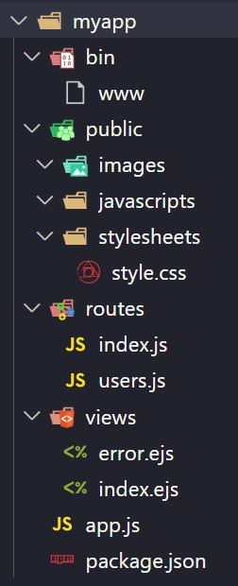
Express Application Generator
Use the application generator tool, express-generator, to quickly create an application skeleton.
npx express-generator --view=ejs myapp
npm install -g express-generator
express --view=ejs myapp
npm install
set DEBUG=myapp:* & npm start

Slide 2
Express Application Generator
myapp – Application/Project Folder
bin – The bin folder contains the executable file that starts your app. It starts the server (on port 3000, if no alternative is supplied) and sets up some basic error handling.
public – Everything​ in this folder is accessible to people connecting to application. We can put JavaScript, CSS, images, and other assets.
routes – We can put all our route files. The generator creates two files, index.js and users.js.
views – The views folder is where we have files used by your templating engine.
app.js File – This file creates an express application object (named app, by convention), sets up the application with various settings and middleware, and then exports the app from the module.

